Slide 1
Camera calibration

Slide 2
References
http://szeliski.org/Book/
http://www.cs.cornell.edu/courses/cs5670/2019sp/lectures/lectures.html
http://www.cs.cmu.edu/~16385/

Slide 3
Camera intrinsics
Camera extinsics
Radial distortion

Slide 4
What is camera calibration
Geometric camera calibration, also referred to as camera resectioning, estimates the parameters of a lens, image sensor, position and view direction of a perspective camera.
You can use these parameters to correct for lens distortion, measure the size of an object in world units, or determine the location of the camera in the scene. These tasks are used in applications such as machine vision to detect and measure objects. They are also used in robotics, for navigation systems, and 3-D scene reconstruction.
[from: https://www.mathworks.com/help/vision/ug/camera-calibration.html]

Slide 5
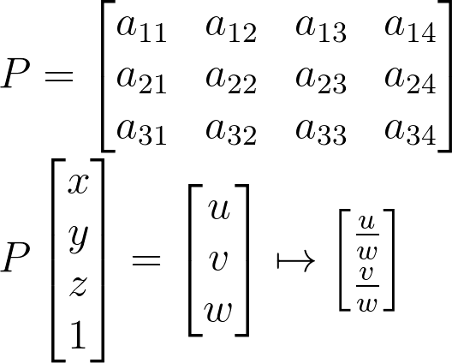
Starting from the end
The camera matrix is a full transformation from 3D objects in the scene to a 2D image with the specific camera parameters:
How many DOFs do we have?
Notes:
\\
P =
\begin{bmatrix}a_{11} & a_{12}&a_{13}&a_{14}
\\ a_{21}&a_{22} &a_{23}&a_{24}
\\a_{31}&a_{32}&a_{33}&a_{34}
\end{bmatrix}
\\
P
\begin{bmatrix}x
\\ y
\\z
\\1
\end{bmatrix}
=
\begin{bmatrix}u
\\ v
\\w
\end{bmatrix}
\mapsto
\begin{bmatrix}\frac{u}{w}
\\ \frac{v}{w}
\end{bmatrix}

Slide 6
Starting from the end
The camera matrix is a full transformation from 3D objects in the scene to a 2D image with the specific camera parameters:
How many DOFs do we have?
11, because in homogenous coordinates the answer is always correct up to a scale.
Notes:
\\
P =
\begin{bmatrix}a_{11} & a_{12}&a_{13}&a_{14}
\\ a_{21}&a_{22} &a_{23}&a_{24}
\\a_{31}&a_{32}&a_{33}&a_{34}
\end{bmatrix}
\\
P
\begin{bmatrix}x
\\ y
\\z
\\1
\end{bmatrix}
=
\begin{bmatrix}u
\\ v
\\w
\end{bmatrix}
\mapsto
\begin{bmatrix}\frac{u}{w}
\\ \frac{v}{w}
\end{bmatrix}

Slide 7
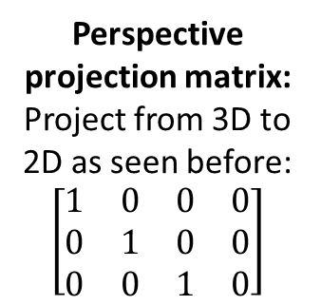
Starting from the end
Intrinsic camera matrix:
estimates the parameters of the lens and image sensor.
Perspective projection matrix:
Project from 3D to 2D as seen before:
$$\left[\begin{matrix}1 & 0 & 0 & 0 \\ 0 & 1 & 0 & 0 \\ 0 & 0 & 1 & 0\end{matrix}\right]$$
extrinsic camera matrix:
estimates the parameters of position and view direction of a camera.
Notes:
P_{3X4} = K_{3X3}[I|0]_{3X4}\Pi_{4X4}

Slide 8
intrinsic

Slide 9



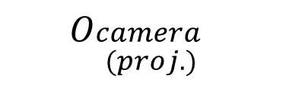
Coordinate systems
There are 3 coordinate systems that are discussed in general:
world point
image point
$$O_{camera}$$
$$O_{\begin{aligned}camera \\ (proj.)\end{aligned}}$$
$$O_{world}$$
$$O_{image}$$

Slide 10




Recap: perspective projection
Perspective projection (also known as perspective transformation) is a linear projection where three dimensional objects are projected on the image plane.
image plane
$$O_{camera}$$
principal axis
Notes:
\begin{bmatrix}x
\\ y
\\ z
\end{bmatrix}
\begin{bmatrix}u
\\ v
\end{bmatrix}

Slide 11
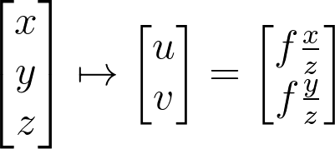
Recap: perspective projection
Using triangle proportions (Thales’ theorem) we can easily conclude that:
image plane
Notes:
\begin{bmatrix}x
\\ y
\\ z
\end{bmatrix}
\mapsto
\begin{bmatrix}u
\\ v
\end{bmatrix}
=
\begin{bmatrix}f\frac{x}{z}
\\ f\frac{y}{z}
\end{bmatrix}

Slide 12
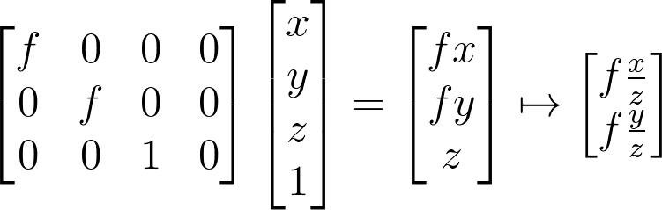

Recap: perspective projection
Let’s use the homogeneous coordinates:
Units of $[m]$
Notes:
\begin{bmatrix}f & 0&0&0
\\ 0&f &0&0
\\0&0&1&0
\end{bmatrix}
\begin{bmatrix}x
\\ y
\\z
\\1
\end{bmatrix}
=
\begin{bmatrix}fx
\\ fy
\\z
\end{bmatrix}
\mapsto
\begin{bmatrix}f\frac{x}{z}
\\ f\frac{y}{z}
\end{bmatrix}

Slide 13
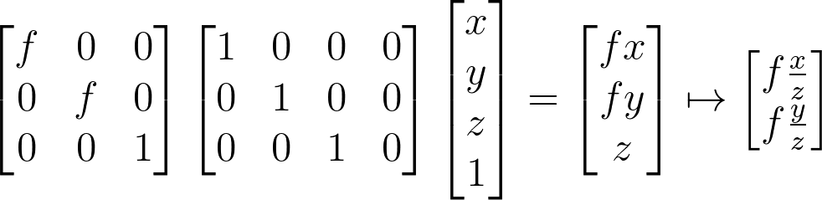
Recap: perspective projection
Let’s split into 2 matrices and use 3D->2D homogenous coordinates:
Intrinsic camera matrix
Perspective projection matrix
Notes:
\begin{bmatrix}f & 0&0
\\ 0&f &0
\\0&0&1
\end{bmatrix}
\begin{bmatrix}1 & 0&0&0
\\ 0&1 &0&0
\\0&0&1&0
\end{bmatrix}
\begin{bmatrix}x
\\ y
\\z
\\1
\end{bmatrix}
=
\begin{bmatrix}fx
\\ fy
\\z
\end{bmatrix}
\mapsto
\begin{bmatrix}f\frac{x}{z}
\\ f\frac{y}{z}
\end{bmatrix}

Slide 14
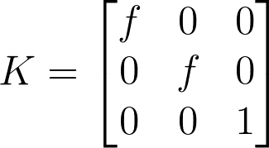
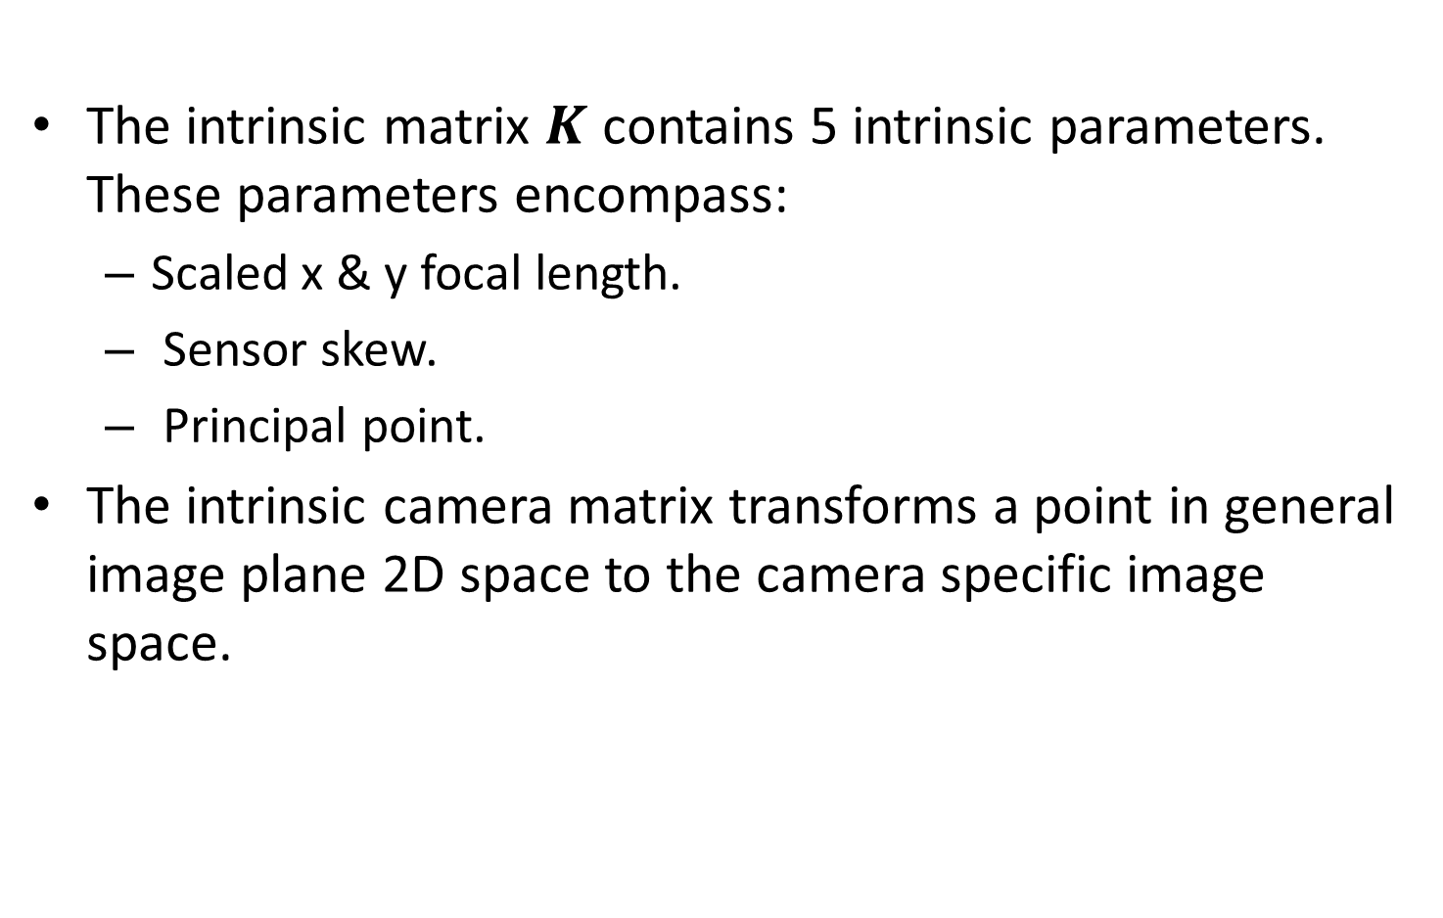
Intrinsic camera matrix
The intrinsic matrix $K$ contains 5 intrinsic parameters. These parameters encompass:
Scaled x & y focal length.
Sensor skew.
Principal point.
The intrinsic camera matrix transforms a point in general image plane 2D space to the camera specific image space.
Notes:
K =
\begin{bmatrix}f & 0&0
\\ 0&f &0
\\0&0&1
\end{bmatrix}

Slide 15
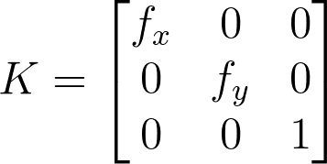

Intrinsic camera matrix
Transforming to units of pixels in image space:
Pixel size in x dimension is $m_{x}$ and Pixel size in y dimension is $m_{y}.$
$$f_{x}=\frac{f}{m_{x}} \&{ f}_{y}=\frac{f}{m_{y}}$$
Notes:
K =
\begin{bmatrix}f_x & 0&0
\\ 0&f_y &0
\\0&0&1
\end{bmatrix}

Slide 16
Intrinsic camera matrix
Let’s add the principle point: the offset vector between the camera coordinates to the image coordinate [units of pixels].
How to add this to the intrinsic matrix?
image plane
camera coordinate system
image coordinate system

Slide 17
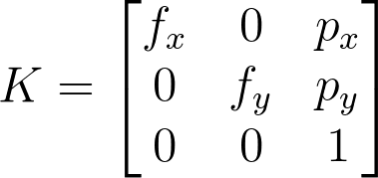

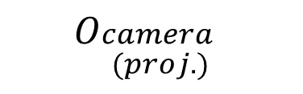
Intrinsic camera matrix
Let’s add the principle point: the offset vector between the projected camera coordinates to the image coordinate [units of pixels].
How to add this to the intrinsic matrix?
image plane
$$O_{\begin{aligned}camera \\ (proj.)\end{aligned}}$$
$$O_{image}$$

Slide 18
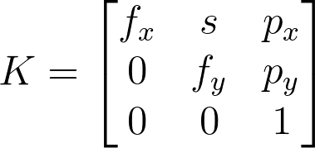
Intrinsic camera matrix
In some camera sensors exist a very small skew which makes the sensor a parallelogram.
Notes:
K =
\begin{bmatrix}f_x & s&p_x
\\ 0&f_y &p_y
\\0&0&1
\end{bmatrix}
==============================
Kx =
\begin{bmatrix}1 & 0&p_x
\\ 0&1 &p_y
\\0&0&1
\end{bmatrix}
\begin{bmatrix}1 & \frac{s}{f_y}&0
\\ 0&1 &0
\\0&0&1
\end{bmatrix}
\begin{bmatrix}f_x & 0&0
\\ 0&f_y &0
\\0&0&1
\end{bmatrix}
x

Slide 19
Extrinsic camera matrix

Slide 20
http://www.vision.caltech.edu/bouguetj/calib_doc/htmls/example.html
https://docs.opencv.org/2.4/doc/tutorials/calib3d/camera_calibration/camera_calibration.html
https://webcourse.cs.technion.ac.il/236873/Winter2017-2018/ho/WCFiles/Camera%20Calibration.pdf
http://ksimek.github.io/2012/08/13/introduction/

